Slide 1


Slide 2
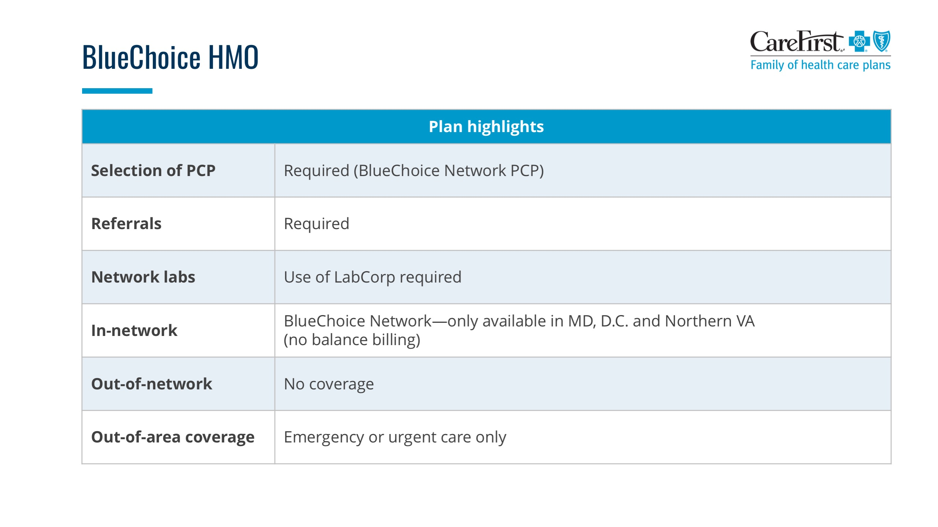

If you do not want to include the comparison scale, select and DELETE the image from the slide.
Click the border of this text box and then press DELETE.

Slide 3
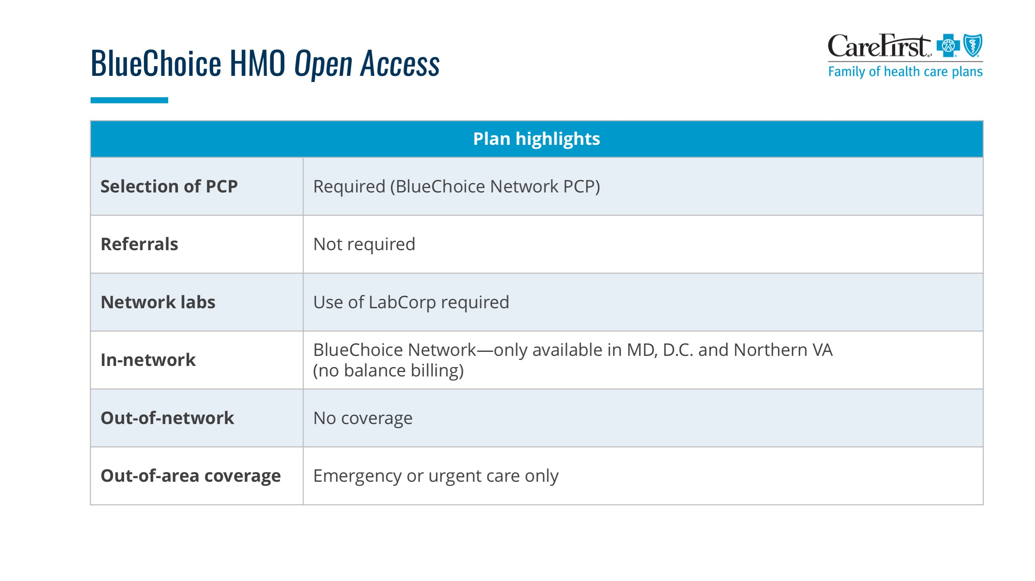

If you do not want to include the comparison scale, select and DELETE the image from the slide.
Click the border of this text box and then press DELETE.

Slide 4
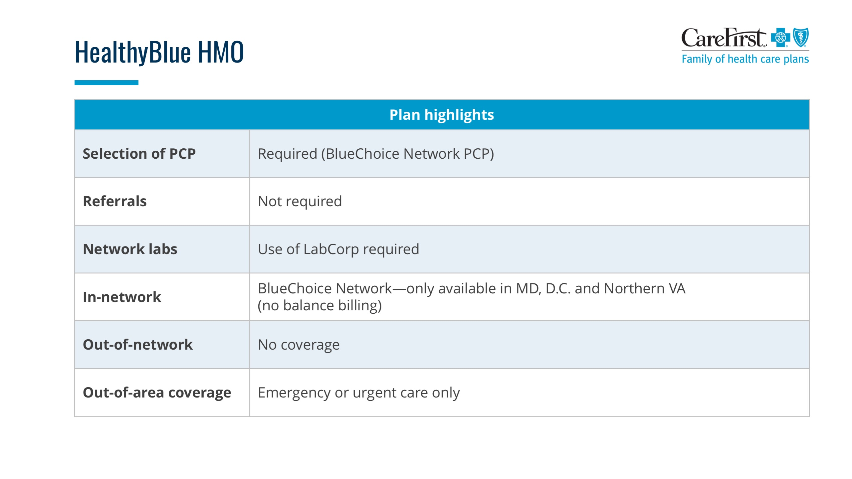
If you do not want to include the comparison scale, select and DELETE the image from the slide.
Click the border of this text box and then press DELETE.

Slide 5
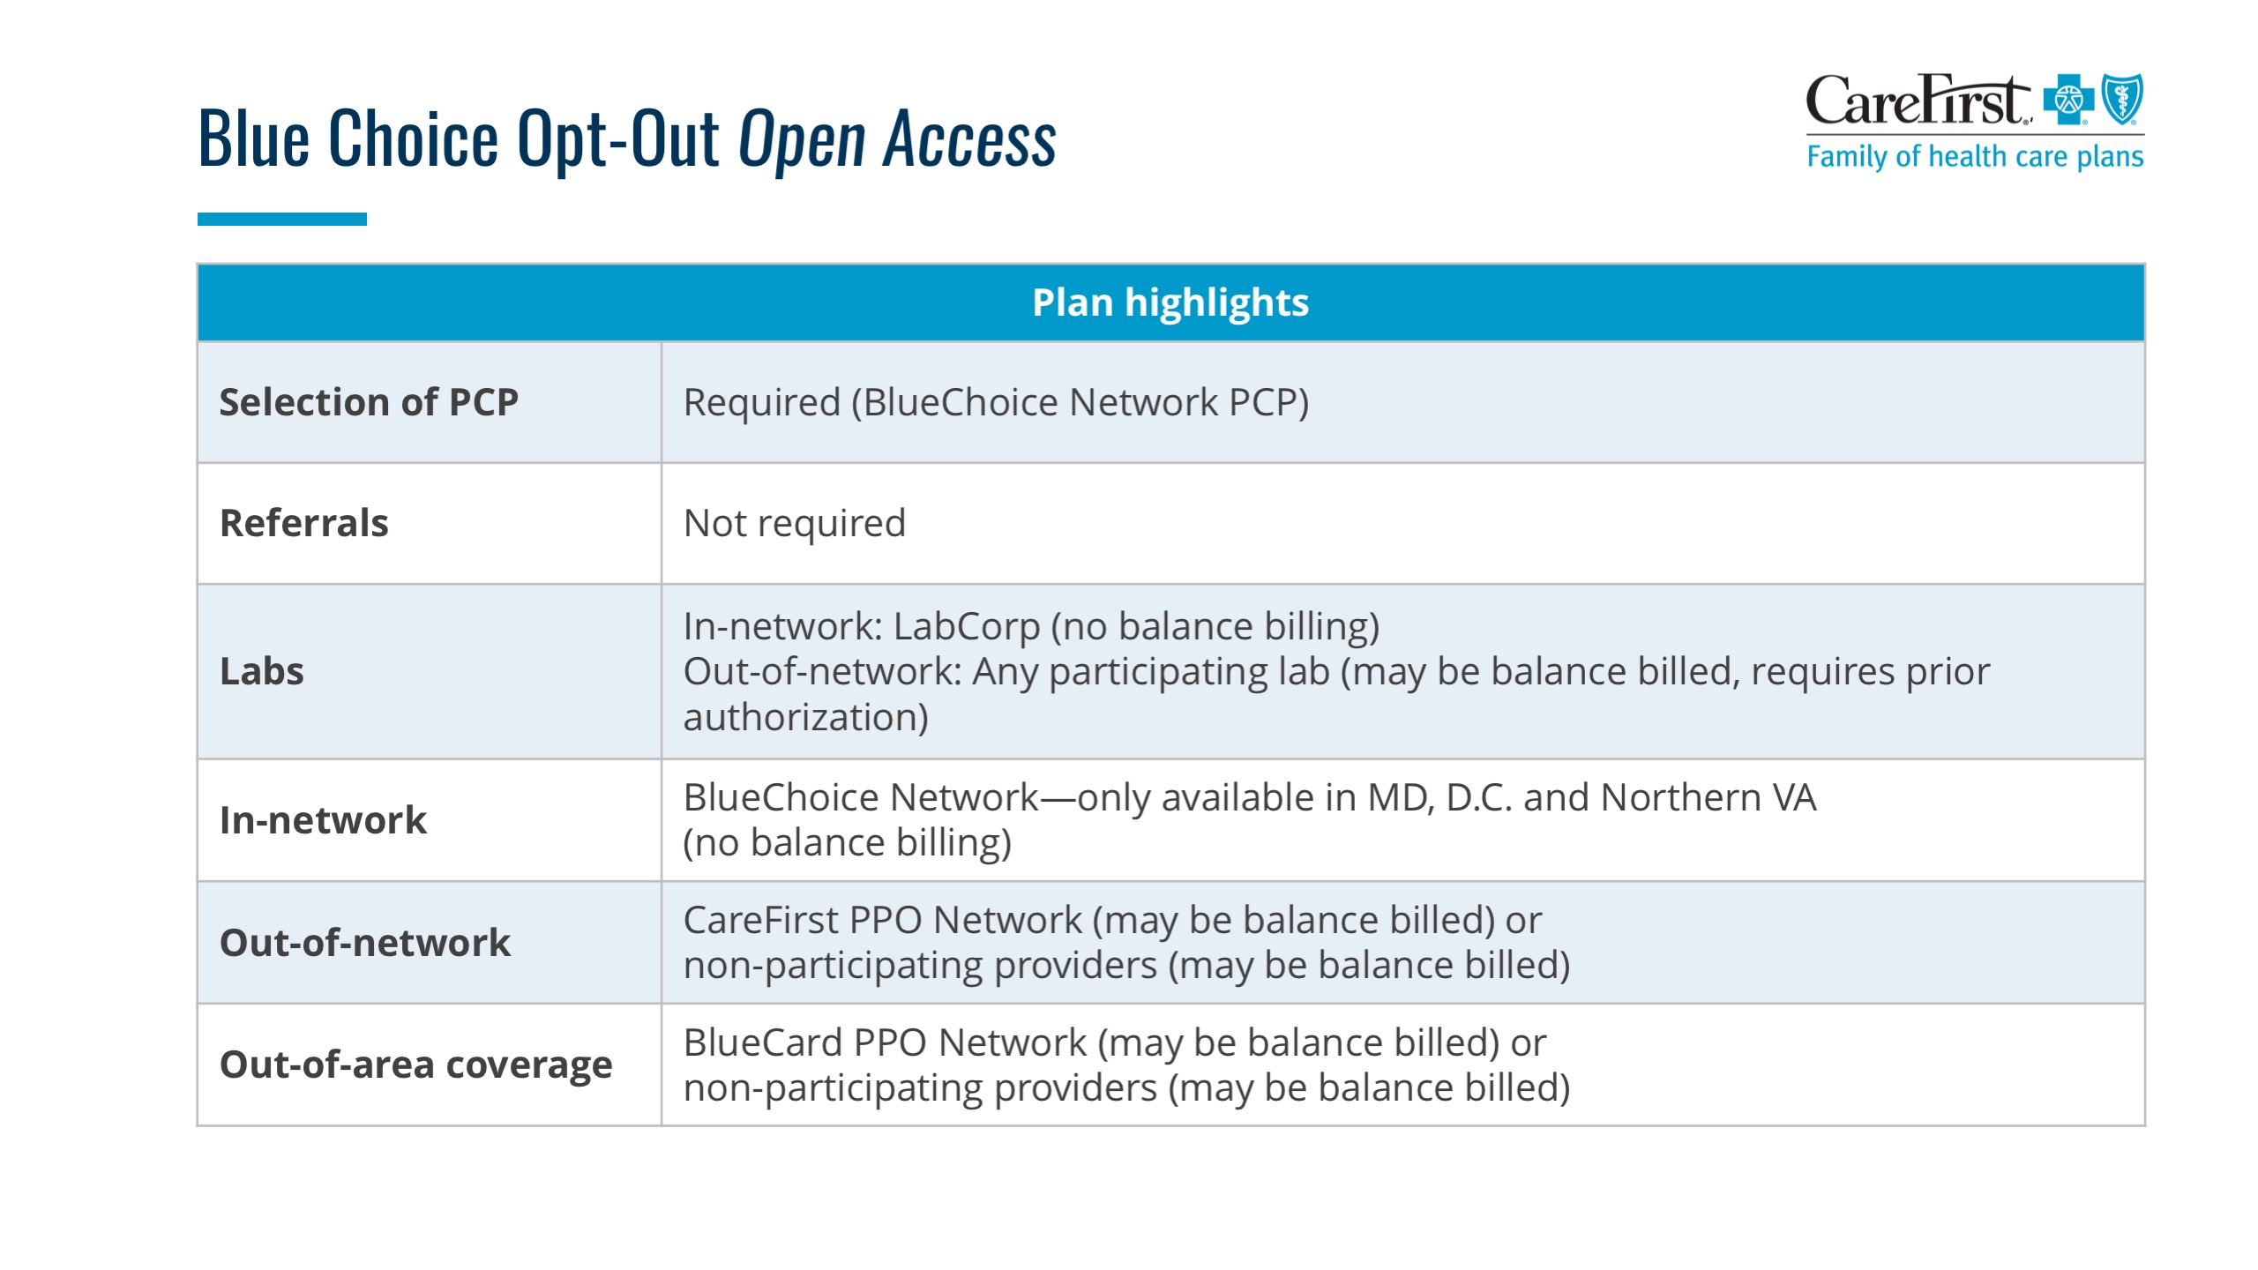

If you do not want to include the comparison scale, select and DELETE the image from the slide.
Click the border of this text box and then press DELETE.

Slide 6
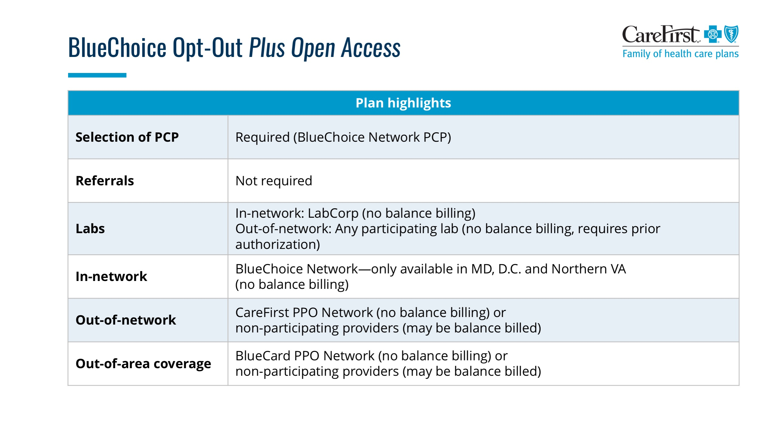

If you do not want to include the comparison scale, select and DELETE the image from the slide.
Click the border of this text box and then press DELETE.

Slide 7
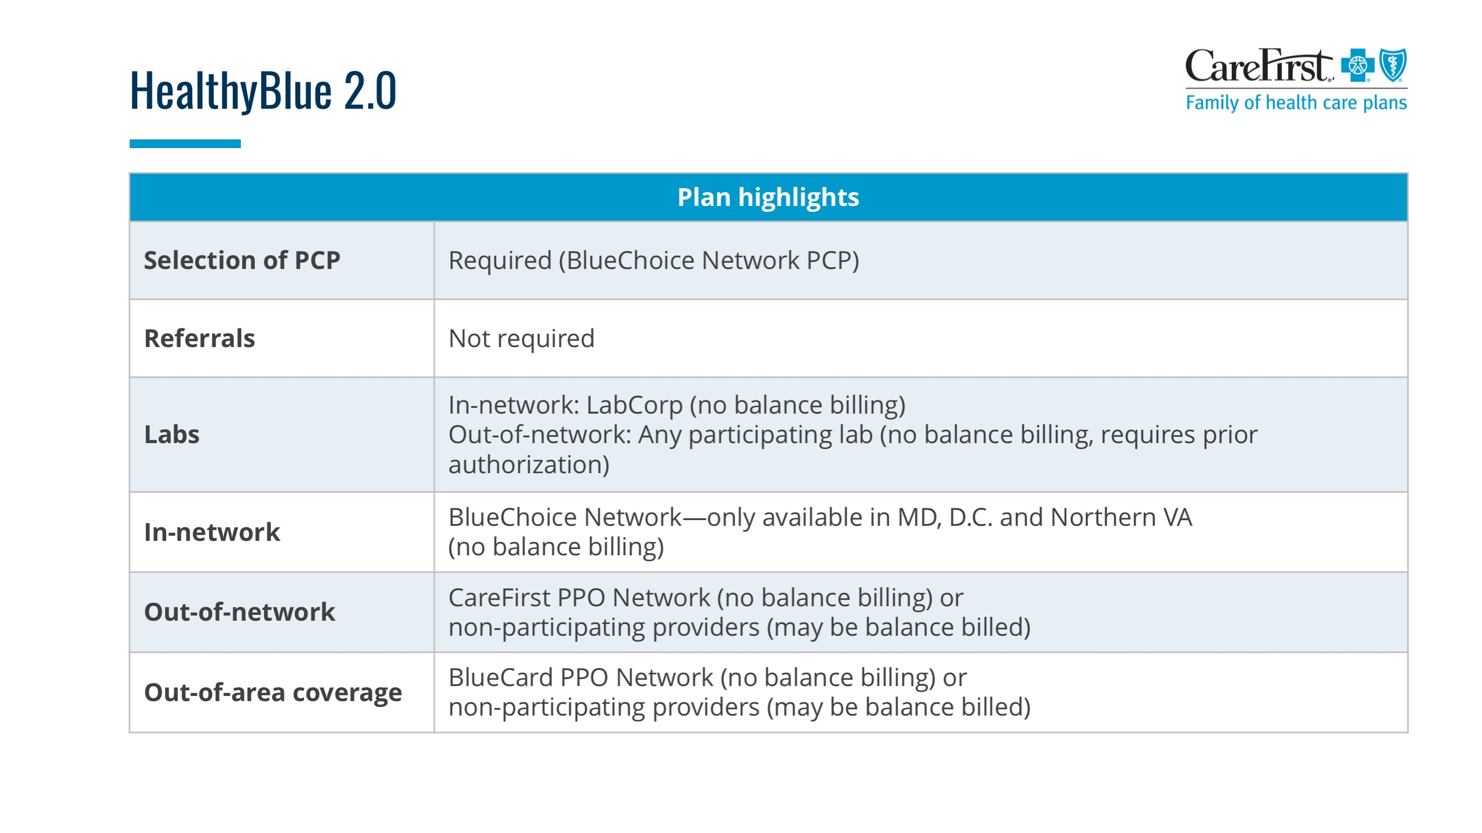

If you do not want to include the comparison scale, select and DELETE the image from the slide.
Click the border of this text box and then press DELETE.

Slide 8
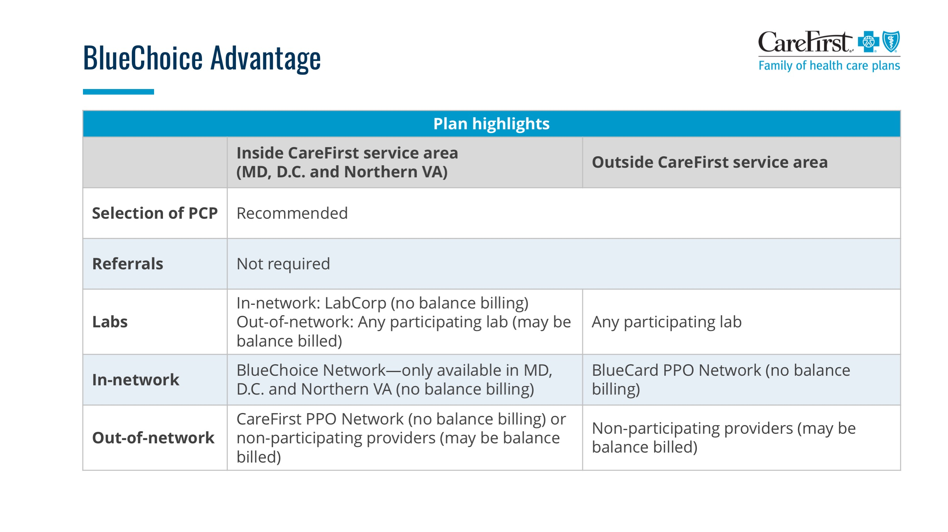
If you do not want to include the comparison scale, select and DELETE the image from the slide.
Click the border of this text box and then press DELETE.

Slide 9
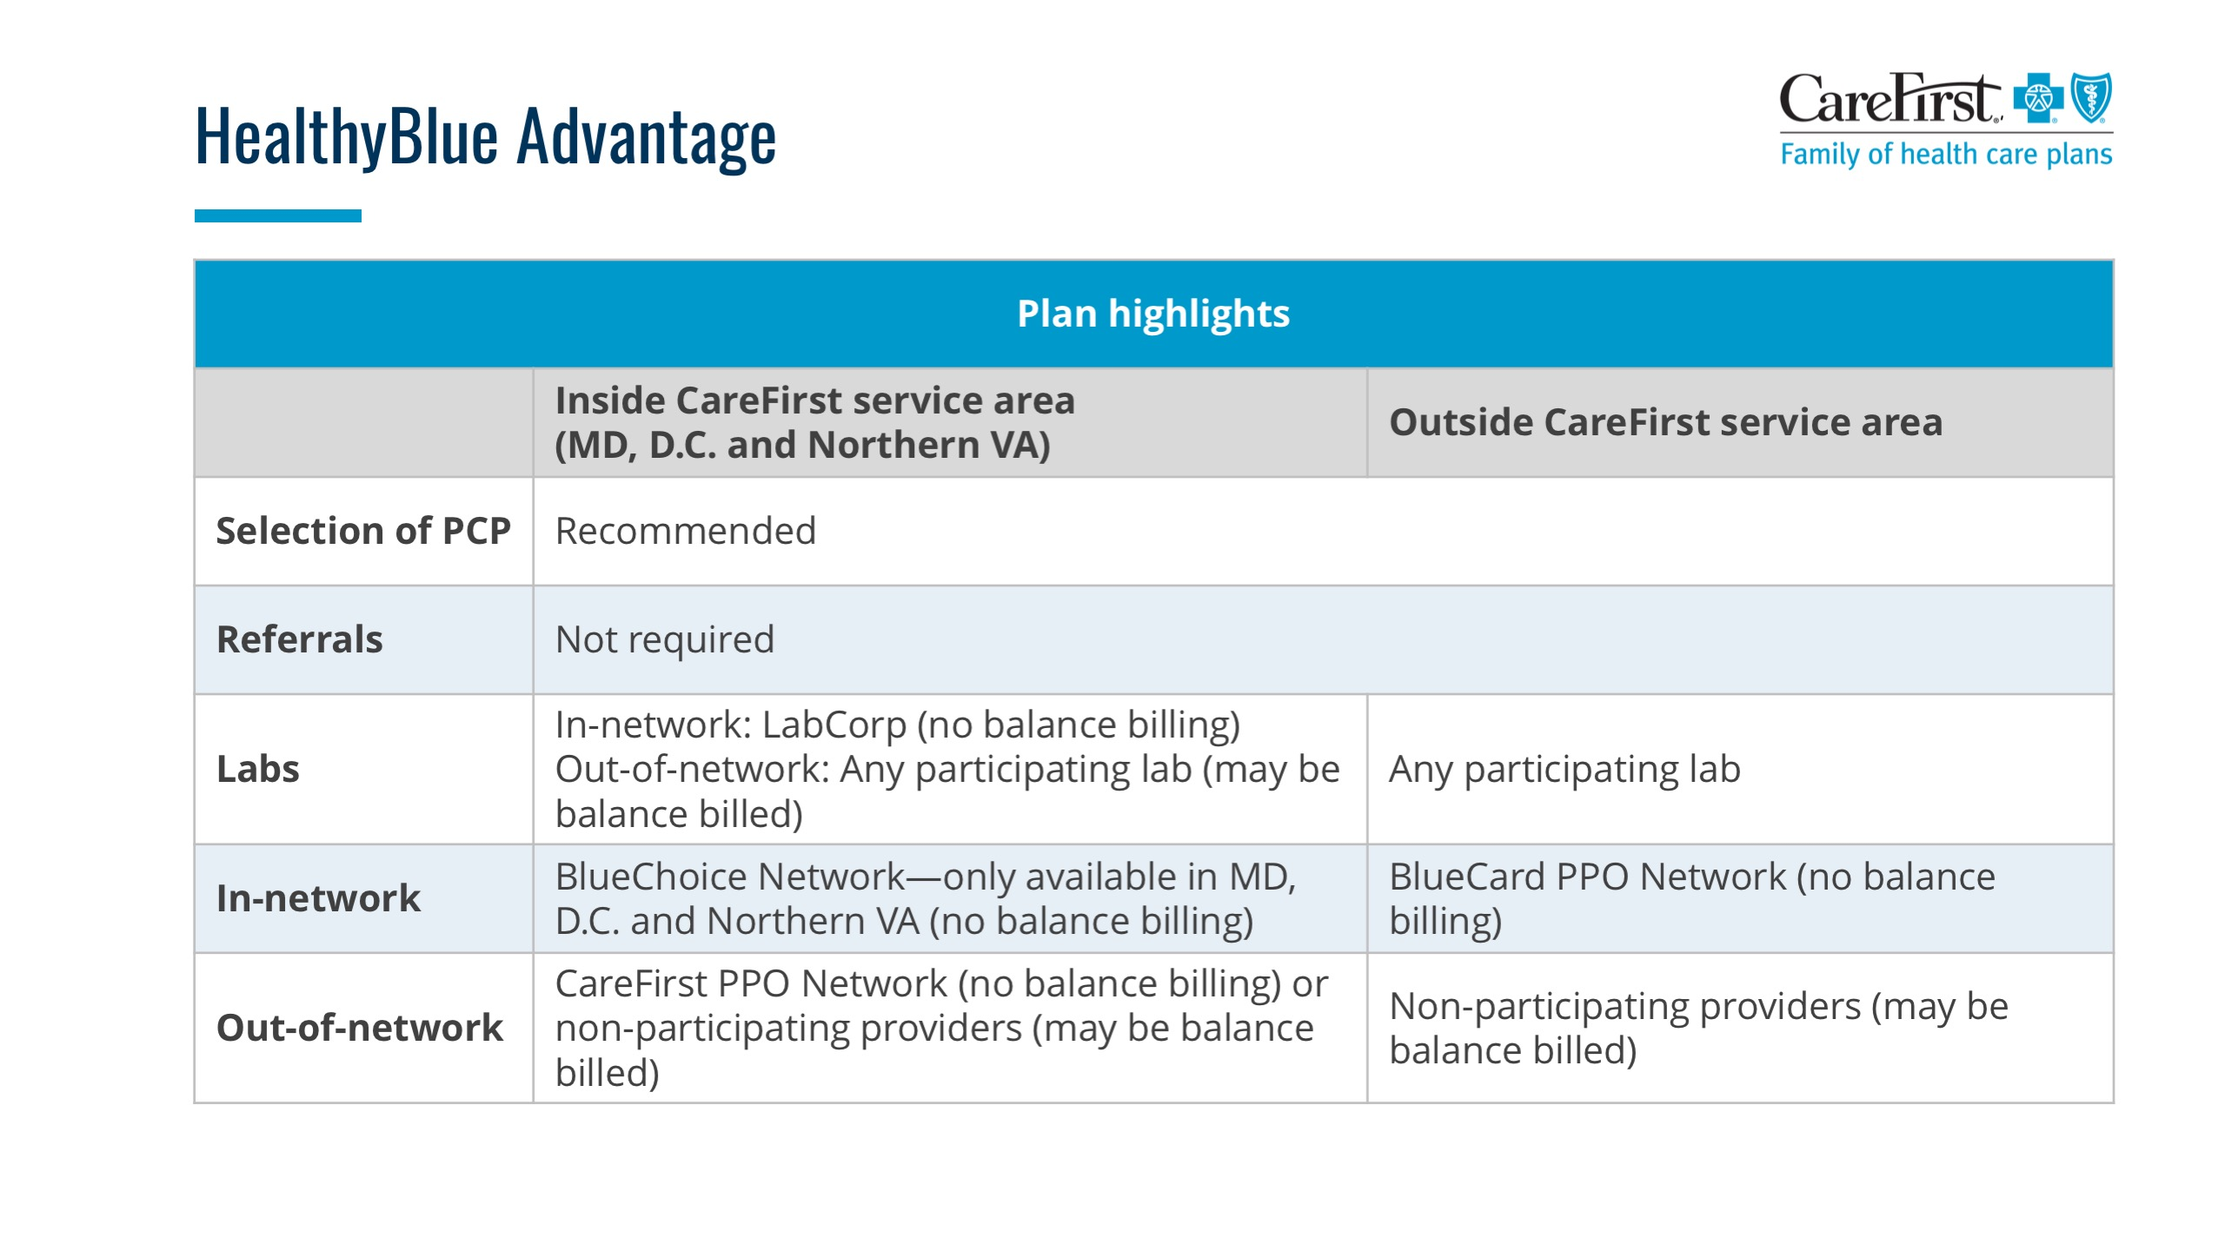
If you do not want to include the comparison scale, select and DELETE the image from the slide.
Click the border of this text box and then press DELETE.

Slide 10
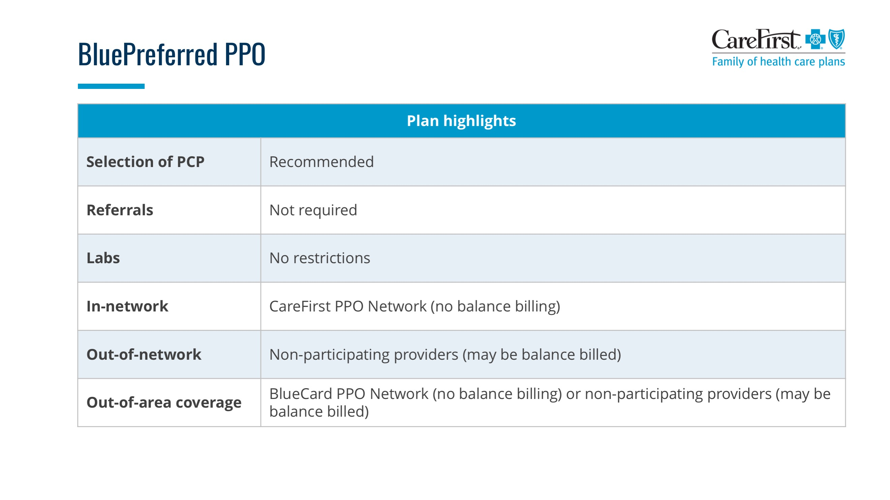

If you do not want to include the comparison scale, select and DELETE the image from the slide.
Click the border of this text box and then press DELETE.

Slide 11
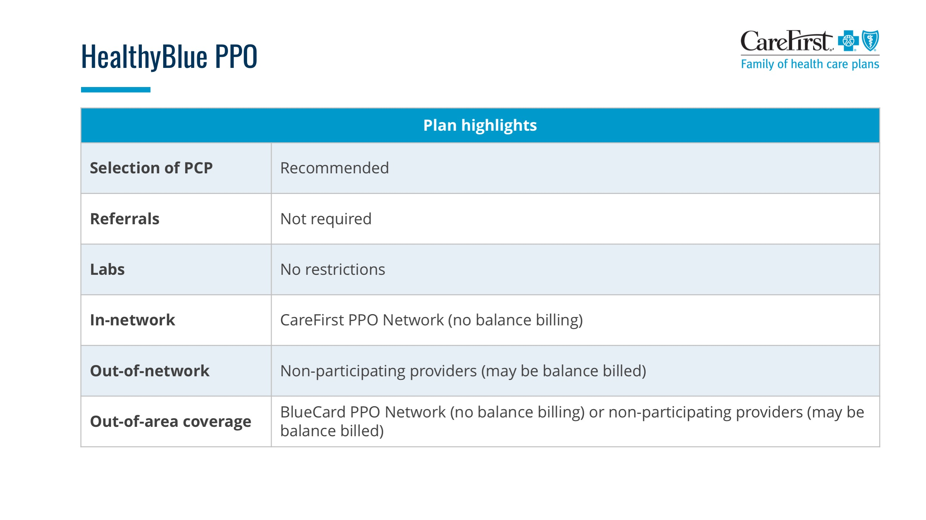
If you do not want to include the comparison scale, select and DELETE the image from the slide.
Click the border of this text box and then press DELETE.

Slide 12
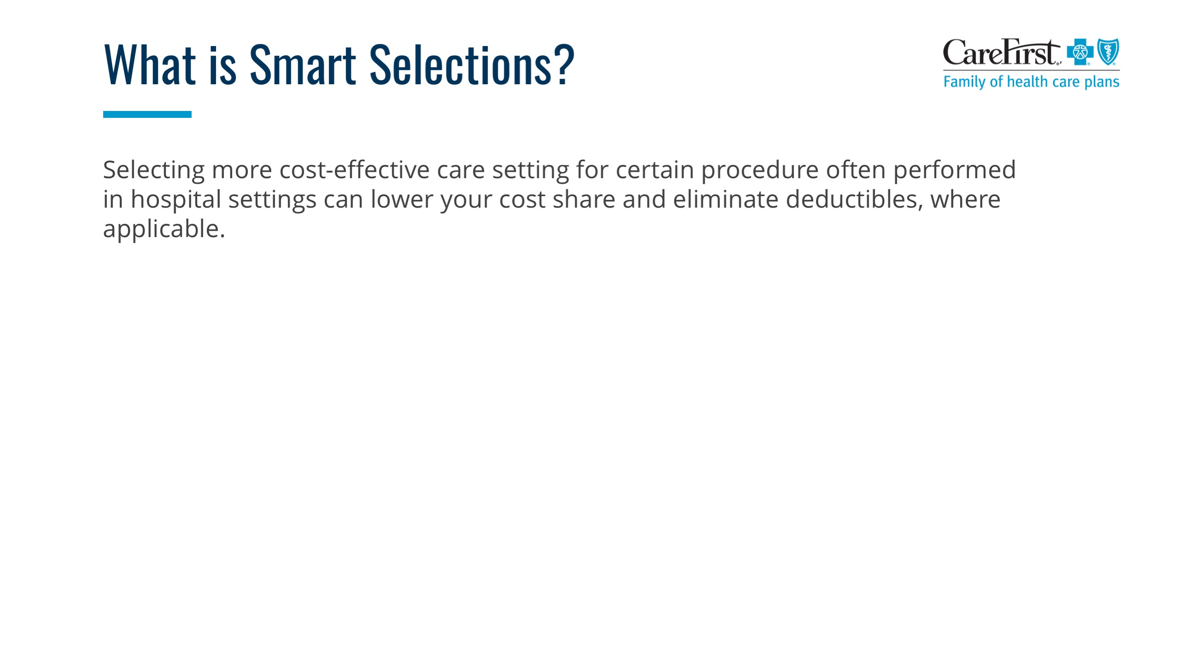
Health care service | Non-hospital setting | Hospital setting
Lab work
X-rays
Outpatient surgery
For Smart Selections only
Customize with your account’s benefits.
Click the border of this text box and then press DELETE.
Notes:
Choosing the right setting for your care is key to getting the best treatment with the lowest out-of-pocket costs. When you understand your options, you can make the best decision when you or your family members need care. Typically, services performed in a non-hospital facility cost less than those performed in a hospital.
Laboratories
You can lower your costs by receiving lab tests at participating national laboratories:
BlueChoice members should use LabCorp to save the most money and avoid extra costs.
PPO members can use either LabCorp or Quest Diagnostics to save the most.
X-ray and imaging facilities
If you need X-rays or other imaging services (MRI, CT scan, etc.), you will pay the least out-of-pocket when you visit a participating imaging center, like Advanced Radiology.
Non-hospital surgery centers (also called ambulatory surgery centers)
Non-hospital surgery centers are health care facilities focused on providing same-day surgical care, including diagnostic and preventive procedures such as colonoscopies, pain management injections and joint repair surgery. If you need outpatient surgery, discuss your options with your provider.

